Slide 1
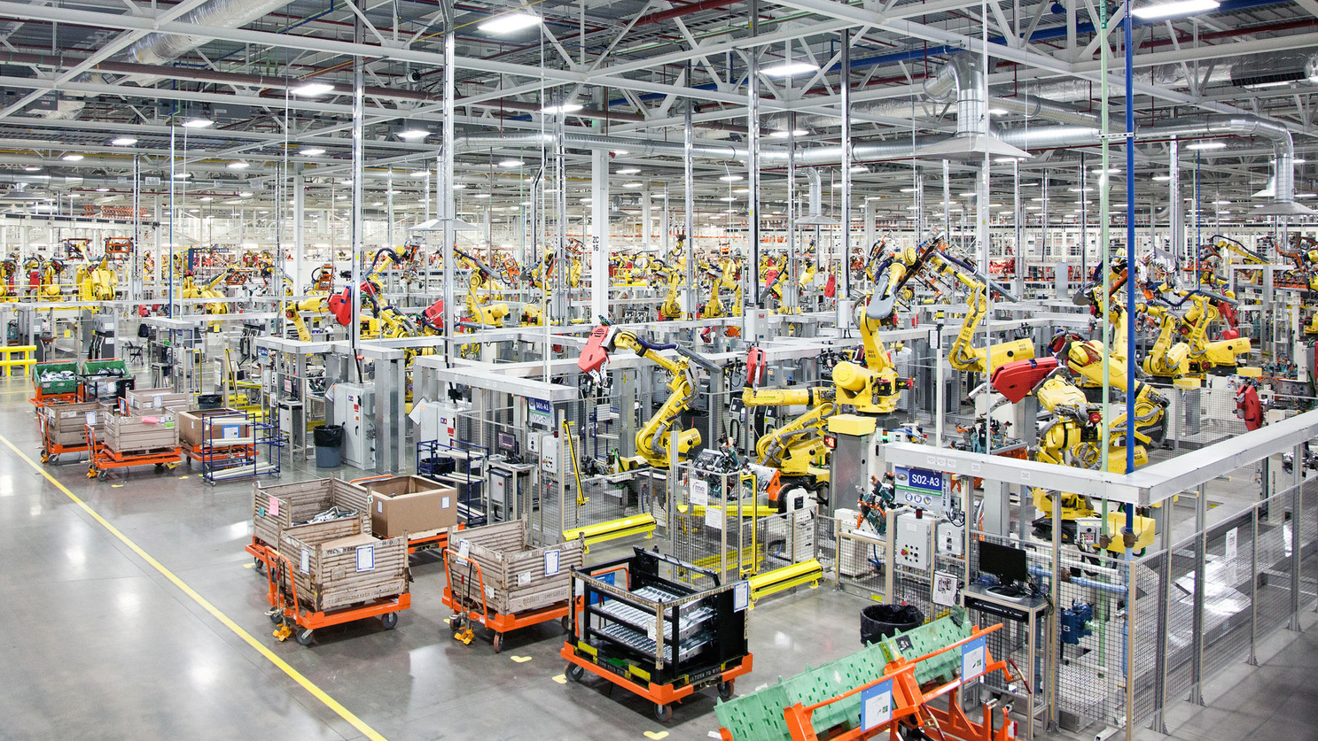
Blockchain-Based Production Line Management System for Smart Factories in Industrial IoT
Utku Acar
CS542.V: Network Security
M.Sc in Computer Science Department
Ozyegin University
Vestel Electronics
Manisa, Turkey
utku.acar@ozu.edu.tr
This Photo by Unknown author is licensed under CC BY-NC-ND.

Slide 2
Abstract
This report presents a blockchain-based production line management system designed for smart factories in the Industrial Internet of Things (IoT) domain. The system aims to enhance the security and efficiency of production line operations, ensuring trust, integrity, and transparency. The report provides an in-depth explanation of the underlying blockchain algorithm used in the system and discusses how these security measures can elevate the functioning of smart factories. The results highlight the potential benefits and challenges of implementing blockchain technology in the Industrial IoT industry.
Index Terms—Smart factories, Internet of Things, blockchain, decentralized services, security, traceability, transparency, trust, scalability, energy consumption, production line management, quality control, and real-time monitoring.

Slide 3
Introduction
Smart factories are revolutionizing the manufacturing industry by leveraging advanced technologies such as IoT, big data, and automation. Efficient management of production lines is crucial for the success of smart factories, ensuring optimized operations, reduced downtime, and improved quality control. However, traditional centralized management systems often lack transparency and are susceptible to security breaches. This report presents a blockchain-based solution to address these challenges and enhance production line management in smart factories.

Slide 4
BLOCKCHAIN ALGORITHM FOR PRODUCTION LINE MANAGEMENT
The proposed production line management system utilizes a blockchain algorithm to ensure secure and transparent data storage and processing.

Slide 5

User Registration and Authentication
Users register with the system by providing necessary information such as username, email, and password.
Upon registration, a unique private/public key pair is generated for each user for authentication purposes.

Slide 6

Production Line and Sensor Management
Authorized users can add production lines and associated sensors to the system.
Each production line and sensor is assigned a unique identifier for easy identification and tracking.
Permissions and access control mechanisms are implemented to manage production lines and sensors.

Slide 7

Sensor Data Generation and Storage
Sensors within the production lines generate data at regular intervals.
The generated data, such as temperature, humidity, and pressure readings, are saved to the blockchain.

Slide 8

Blockchain Storage and Integrity
The blockchain consists of a series of blocks, where each block stores a set of sensor data.
Each block contains a cryptographic hash of the previous block, creating a chain-like structure.
The inclusion of timestamps, production line IDs, sensor IDs, and elapsed time ensures the integrity and traceability of the stored data.

Slide 9

Block ID Generation
The block ID is a unique identifier assigned to each block in the blockchain.
It is calculated using a cryptographic hash function that incorporates various parameters from the block, such as the previous block’s hash, timestamp, production line ID, sensor ID, and elapsed time.

Slide 10
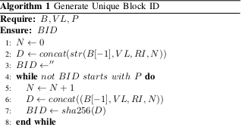
Block ID Generation
B: Blockchain, which is a data structure containing the previously generated blocks.
VL: Values List, a collection of values associated with the current block.
P: Starting Pattern, a specific pattern that the Block ID should begin with.
BID: Block ID, a unique identifier assigned to each block in the blockchain.
N: Nonce, a value used in the generation of the Block ID.
D: Block Data, a string formed by concatenating the previous block’s hash, Values List, Random Identifier (RI), and Nonce

Slide 11
Block ID Generation
The algorithm aims to generate a unique Block ID by repeatedly calculating the hash of the Block Data and incrementing the Nonce until the Block ID starts with the desired Starting Pattern P. This ensures that the generated Block ID meets the specified criteria and can be used as an identifier for the block within the blockchain.

Slide 12
Block ID Generation
By iteratively adjusting the Nonce and recalculating the Block ID, the algorithm ensures that each block has a unique identifier that satisfies the required condition. By incorporating these parameters into the block ID generation formula, the system ensures that each block in the blockchain has a unique identifier that reflects its position, associated production line and sensor, and the time it was added to the chain. This enhances the traceability and integrity of the stored data within the blockchain.

Slide 13

SECURITY MEASURES AND BENEFITS
The blockchain-based production line management system provides several security measures that elevate the functioning of smart factories:

Slide 14

Immutable Data Storage
The immutability of blockchain ensures the integrity of stored sensor data, making it tamper-resistant.
The decentralized nature of blockchain technology prevents unauthorized modifications to the data

Slide 15

Secure Authentication and Access Control
Private/public key pairs and user authentication mechanisms enhance security and prevent unauthorized access.
Permissions and access control mechanisms enable fine grained control over user privileges and secure production line management.

Slide 16
Distributed and Decentralized Architecture
The decentralized nature of blockchain eliminates single points of failure and enhances system resilience.
Distributed consensus protocols ensure data validation and verification by multiple nodes, improving overall security .

Slide 17
CHALLENGES AND FUTURE DIRECTIONS
While the blockchain-based production line management system offers significant advantages, it also faces certain challenges:

Slide 18

Scalability
Blockchain technology faces scalability limitations due to the increasing size of the blockchain and the associated computational overhead.
Further research and optimization are required to address scalability concerns in large-scale smart factories.

Slide 19

Integration Challenges
Integrating the blockchain system with existing production line management infrastructure may require significant modifications and compatibility considerations.
Seamless integration with other IoT devices and platforms should be a key focus for future development.

Slide 20
Energy Consumption
The computational resources required for blockchain consensus and validation processes result in significant energy consumption.
Exploring energy-efficient consensus algorithms and sustainable blockchain solutions is crucial for minimizing the environmental impact [7].

Slide 21
RESULTS
The impact of the block number on the elapsed time was analyzed for two cases: one where the block IDs start with a single zero prefix (Figure 1), and the other where the block IDs have two prefix zeros (Figure 2).

Slide 22

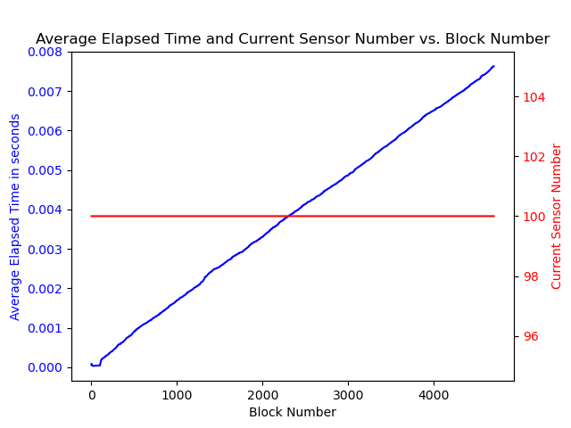
RESULTS
In the case where the block IDs start with a single zero prefix (Figure 1), there were 5000 blocks present, and the average elapsed time for each block was 0.06 seconds.

Slide 23
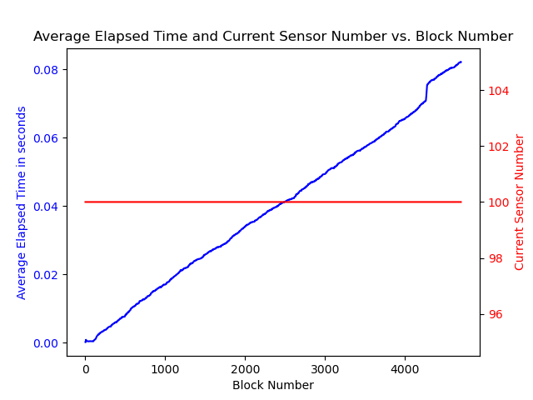
RESULTS
In the case where the block IDs start with two prefix zeros (Figure 2), there were also 5000 blocks present, but the average elapsed time for each block was 1 second.

Slide 24
RESULTS
The comparison of these cases reveals that the number of zeros in the block ID prefix has a significant impact on the elapsed time. The case with a single zero prefix resulted in a much lower average elapsed time per block compared to the case with two prefix zeros. This difference can be attributed to the increased computational complexity and processing time required for generating block IDs with more zeros in the prefix. Further analysis and optimization may be necessary to improve the performance and reduce the elapsed time for cases with a higher number of prefix zeros in the block IDs.

Slide 25

RELATED WORK
Several research studies have explored the application of blockchain technology in the context of production line management and smart factories. This section provides an overview of relevant works in this field.

Slide 26

Blockchain-enabled supply chain management in smart factories
Smith et al. proposed a blockchain-based system for supply chain management in smart factories. Their system leveraged blockchain’s decentralized and immutable nature to enhance transparency and traceability in the supply chain. The authors conducted experiments and demonstrated the effectiveness of their solution in improving supply chain efficiency and reducing fraud.

Slide 27
Blockchain-based production line management for smart factories
Johnson and Lee presented a blockchain-enabled production line management framework for smart factories. Their system utilized blockchain’s secure and transparent nature to enhance data integrity and enable the secure sharing of production line information. The authors conducted a case study and showed the potential benefits of their solution in terms of increased operational efficiency and reduced downtime.

Slide 28
Blockchain-based quality control system for smart factories
Gupta et al. proposed a blockchain-based approach for quality control in smart factories. Their system utilized blockchain’s immutability and decentralized consensus to ensure the integrity and authenticity of quality control data. The authors conducted experiments and demonstrated the effectiveness of their solution in improving quality control processes and reducing errors.

Slide 29
Blockchain-enabled real-time monitoring and control of production lines in smart factories
Wang et al. presented a blockchain-based system for real-time monitoring and control of production lines in smart factories. Their system integrated blockchain with IoT technologies to enable real-time data collection, secure storage, and automated control of production line operations. The authors conducted simulations and showed the advantages of their solution in terms of improved productivity and adaptive control.

Slide 30
Related Works
These works highlight the growing interest in leveraging blockchain technology for production line management in smart factories. Each study explores different aspects of blockchain’s capabilities and demonstrates its potential to enhance security, transparency, and efficiency in the context of industrial IoT.

Slide 31
Conclusion
This report presented a blockchain-based production line management system designed for smart factories in the Industrial IoT industry. The system utilizes a secure and transparent blockchain algorithm to enhance the security and efficiency of production line operations. By ensuring data integrity, secure authentication, and decentralized architecture, the system offers several benefits for smart factories. However, scalability, integration challenges, and energy consumption remain areas for further research and improvement.

